Slide 1
Strategic Business Plan for Walmart, Inc.
Name:
Institution:
Date:

Slide 2
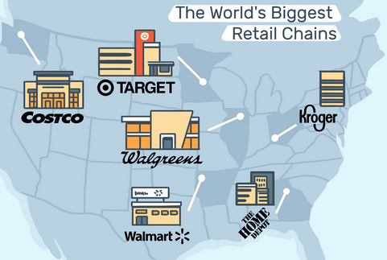
Strategic Focus in Retail Industry
Intense competition in the U.S. industry
Largely an oligopolistic structure
Characterized few but large entities
Need competitive advantages
Strategic focus is key

Slide 3
Walmart’s Business opportunities
Started as a single store in downtown Rogers
Strategic focus inspired the growth
Critical success factors;-
Low-cost leadership status
Customer experiences
Accessibility
Wide assortments

Slide 4
Products and Service-delivery
Availability of range assortments is key to service-delivery
Key product portfolios include;-
General Merchandises
Groceries
Health and Wellness
Sourcing strategies aim to harness sustainability
Supplier inclusivity and responsible sourcing key strategies

Slide 5
Segments and Service delivery
Walmart operates in four segments to enhance access to the merchandises
The key segment;-
Walmart U.S.
Walmart International
Sam’s Club
The company operates its store using various approach that include Discount, Neighbor Markets, and Supercenter
E-commerce has become a competitive segment

Slide 6
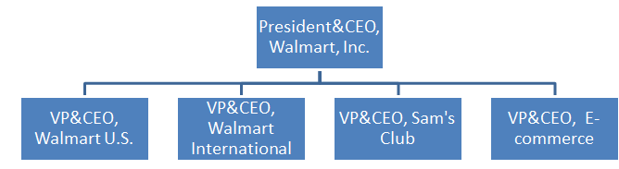
Organization and Management
A Hierarchical and functional organizational structure
Hierarchical structure outlines chain of command
Easy to resolve conflicts
Cross-functional consultations are possible
Career progression is possible

Slide 7
Market Analyses
The rise of consumerism as a global trend initiate strategic realignment
Consumerism exerts pressure on retailers to integrate responsible sourcing
Walmart, Inc. resolved to remodel its business operations to include technologies
Recently, the China-U.S. trade war has impacted the retail sector because of tariffs
Successful use of technology helps to alleviate the inter-trade war

Slide 8
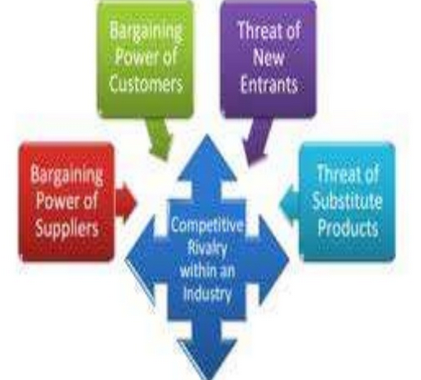
Market competitiveness

Slide 9
Market competitiveness (cont.ed)
Bargaining power: Walmart maximizes its competitiveness using supplier optimization strategy
Rivalry: Walmart faces intense rivalry from competitors . E.g. Amazon.com is a direct competitor in e-commerce.
Threats of New Entrant: refers to the ease of entry into the retail and cause disruptions. The oligopolistic nature create barriers.
Threat of substitute products: Strategic focus help to hedge against threats from substitute goods by availing range of assortments

Slide 10
Strategic Focus and Risk Management
Organizations face uncertainty during the execution of plan
Uncertainty represents the degree of risk
Strategic planning necessitates categorizing key risks
Categories used at the Walmart are generic
Walmart faces strategic, operational, finance, and compliance risks

Slide 11
Strengths and Weaknesses
Key strengths
Key weaknesses
Strategic locations
Strong ICT capability
Global supply chain to minimizes overdependence
Large workforce
Wide assortments of merchandises
High turnover rate
High cost of insurance
Inability to replicate successes in one segment to the other
The EDLP maximizes benefits when there is bulk-buying

Slide 12
Environmental and Social-impact
The primary goal is to minimize negative environmental and social impact using ESG agenda
Environmental goals:
By 2025, to segments to acquire fresh, seafood, and farm produces from the sources certified to use sustainable approaches
Social goals:
By 2025, to expand the economic opportunity in the retail supply chain using the $100M Retail Opportunity Kitty to develop 1 million small farmers

Slide 13
Key Strategy: sustainable supply chain
Focus on sustainable supply chain
Adopting the 20x25 sourcing model:
The program prioritizes 20 merchandises that can be sourced sustainably by the year 2025
The model requires cooperation
Walmart has to convince the suppliers to integrate sustainable practices
Consumers have to prefer sustainably sourced merchandised

Slide 14

Key strategy: Increased Community Engagement
Every organization operates in a community
Strengthening community is key to eliminate negative social-impacts
Walmart provides access to food and other charitable programs
Advancing economic opportunity using grants and other support mechanisms

Slide 15
Conclusion
Sam Walton did not invent retailing
However, his ability to harness strategic planning to gain focus was a critical success factor
The growth from a single store to a multinational entity emanate from management insights
Contemporary entrepreneurs gain pertinent knowledge on the role of strategic management in business
A notable insight is the need for regular environmental scanning using PESTLE or Porter’s forces of industrial competitiveness

Slide 16
recommendation
Adopt outsourcing for the non-core activities
Reconsider the capital allocation strategy used
More emphasize should focus on achieving leadership status in technology and e-commerce capability
Undertake short-term and regular review on the performance of the ESG agendas

Slide 17
references
Geddees, I. & Perkins, B. (2019).Retail trends 2019: Retail Re-invented, London, UK: Deloitte
Lambardo, J. (2019, February 15). “Walmart: Organizational structure and organizational culture,” The Panmore.com.
Olsen, E. (2013). Strategic Planning for Dummies, Hoboken, N.J: John Wiley & Sons
SEC. (January 2019) Form 10-K Annual Report for Walmart INC, Washington, DC: AUTHOR
Volberda, H., Heij, K., & Bosch, J. (2017). Reinventing business models: How firms cope with disruption, Oxford: Oxford University Press
Smith, M. (2019 April). IRL interactive display GIF, Bentonville, Ark: Walmart
Walmart.com. (n.d.). Walmart.com’s history and mission, Bentonville, AR: AUTHOR

